Slide 1
Who’s Who
January 2024

Slide 2
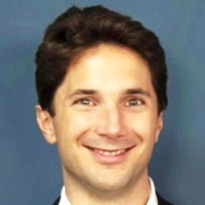
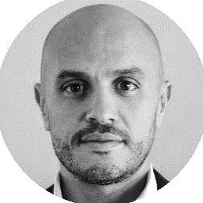
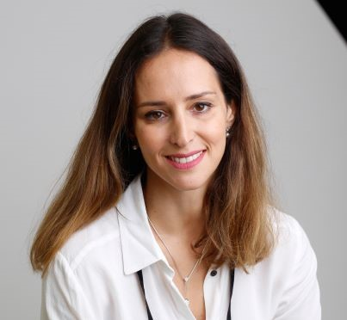
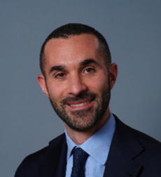
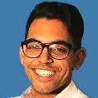

Infomineo Executive Committee
Infomineo Executive Committee
Managing Partners
Martin Tronquit
Dubai
Hamza Laraichi
Casablanca
Chief Human Capital Officer
Chief Growth
Officer
Chief Operating Officer
Finance Director
Dounia Boutaleb
Barcelona
Matteo
Gamberale
Dubai
Faizel Logday
Barcelona
Romain
Murigneux
Barcelona

Slide 3

Business Research
Graphic Design
Business Translation
Data Analytics
Finance
Human Capital
Information Technology
Operations
Office Admin
Marketing
Delivery
Business Lines
Service
Infomineo teams are split into different service lines
Business Development
Business Development (sales)

Slide 4
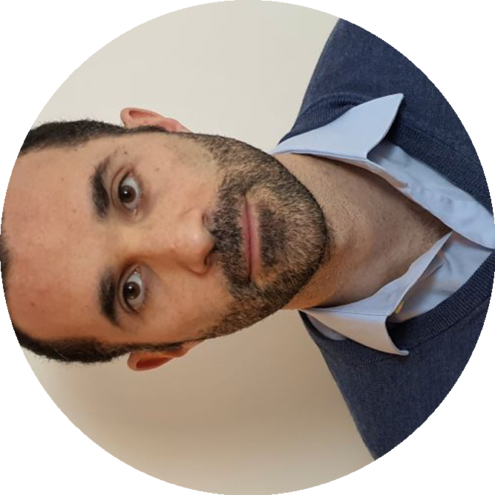

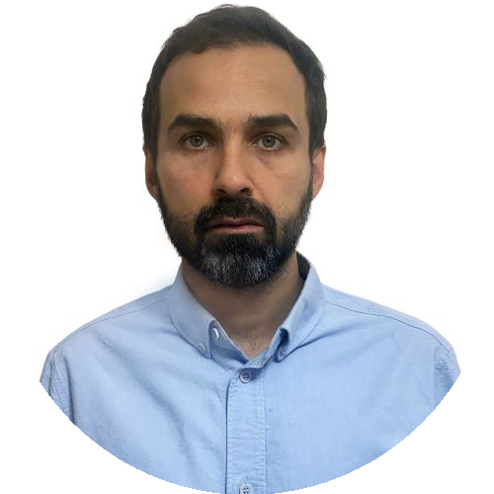
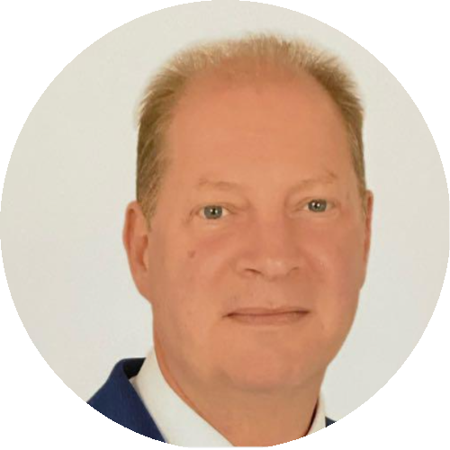

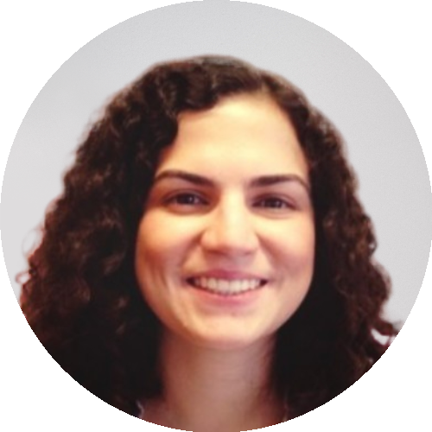
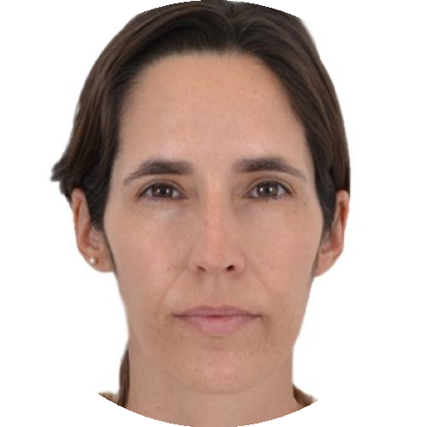
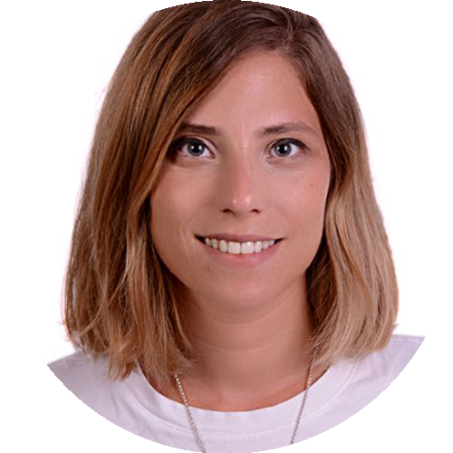

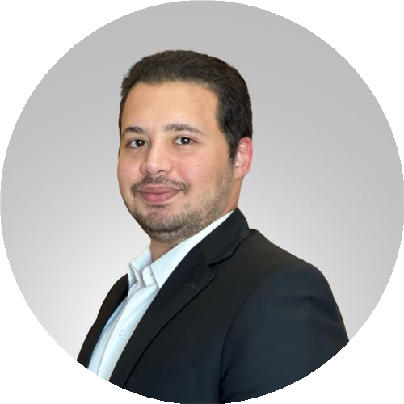
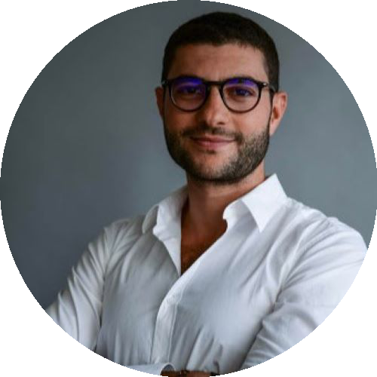
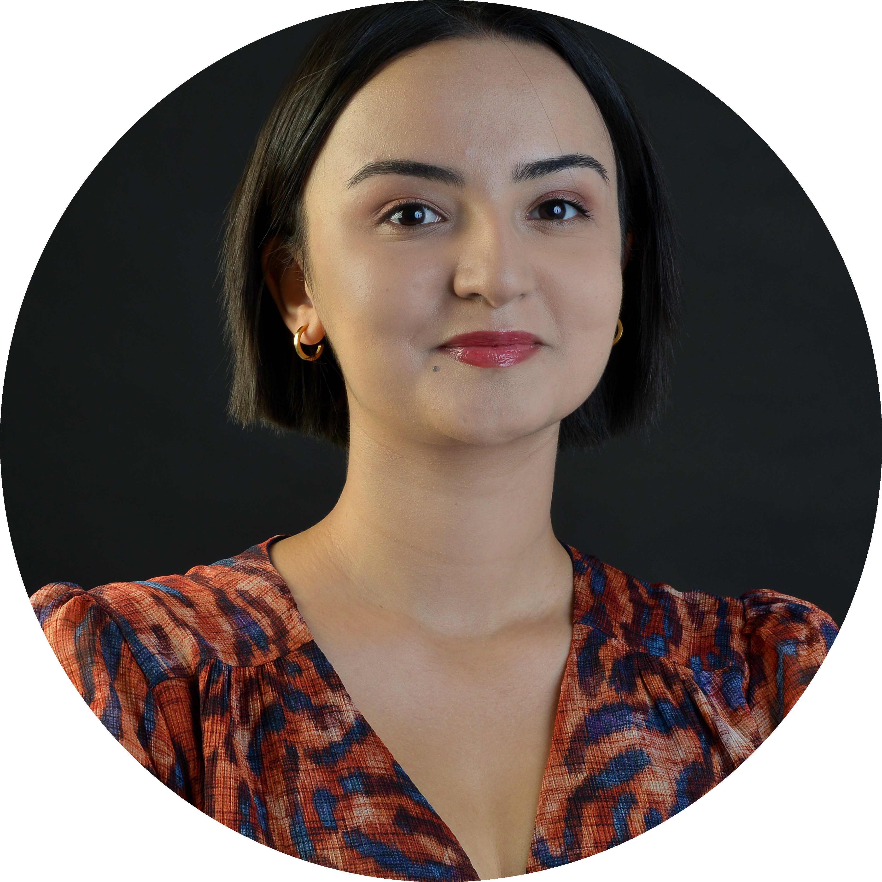


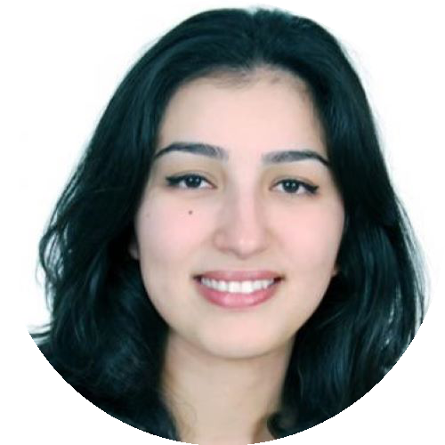
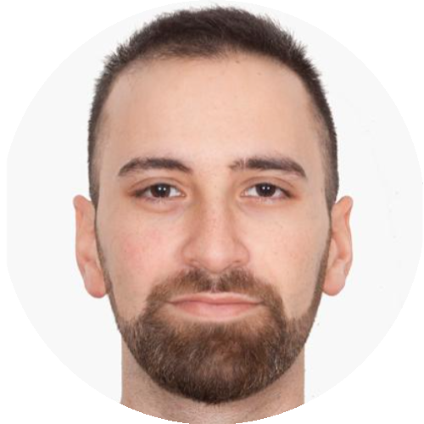
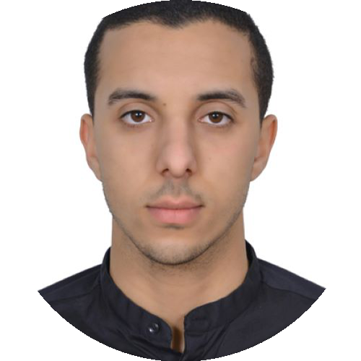
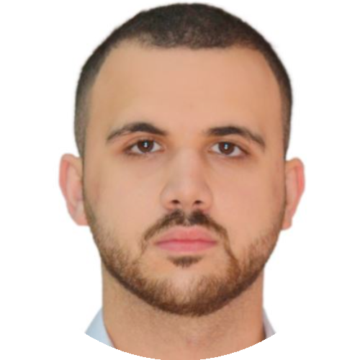
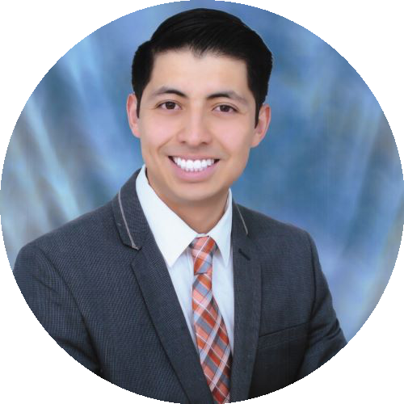
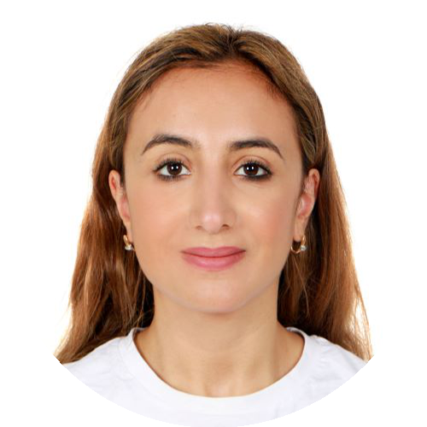
Business Development Team
Who are they?
What do they do?
Identifying business opportunities
Matteo Gamberale Chief Growth Officer
Mapping key stakeholders & defining the appropriate action plan
Senior Vice Presidents
Vice Presidents
Coordinating proposals and contracting processes
Dmitry Linkov
Keith Vann
Clarissa Confort
Ines Benincasa
Noran El Atawi
Associate Vice Presidents
Maintaining an updated CRM
BD Lead
Providing clients with necessary collaterals
Mohanad El Tantawy
Saad Iben Brahim
Nada Benslimane
Developing an Account Management & planning for each key account
Senior Account Executives
Account Executives
Oumaima Fennane
Hossein Lakkis
Othmane Boubkry
Ramzi Chaaban
Daniel Orozco Ibazeta
Yasmine Benhalima

Slide 5
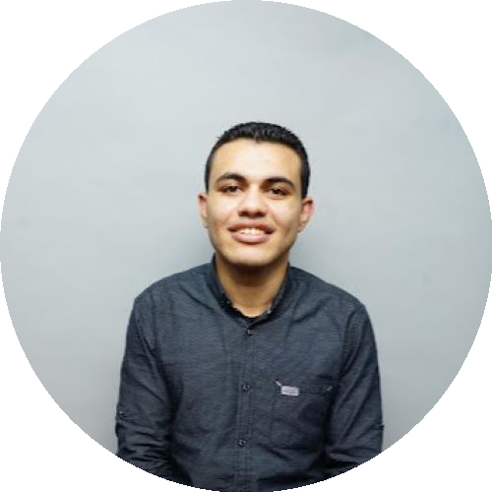
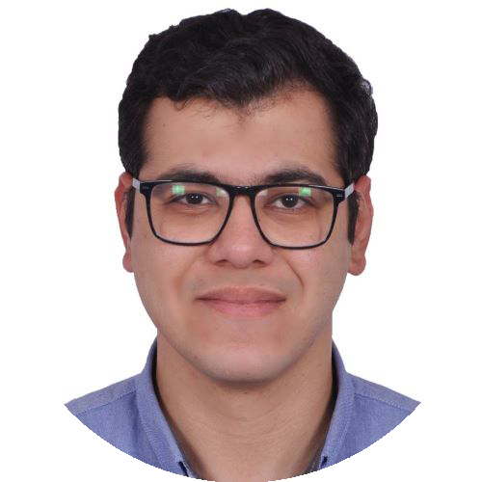
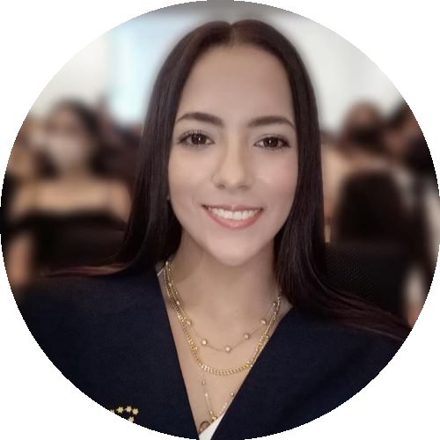
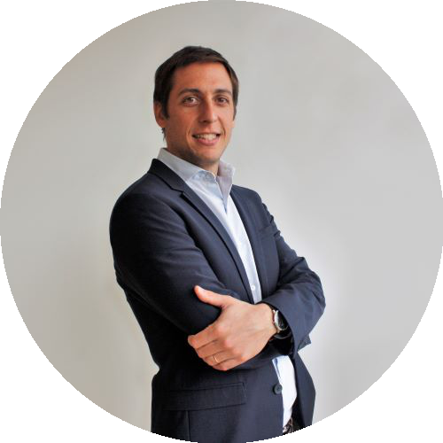

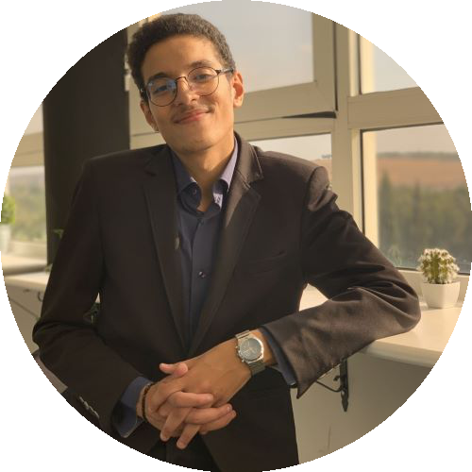
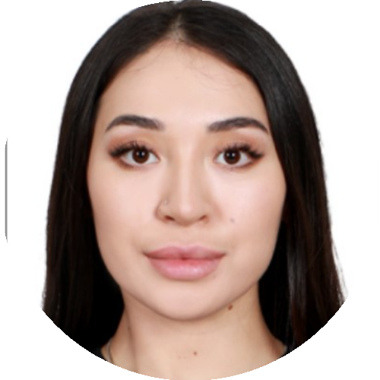
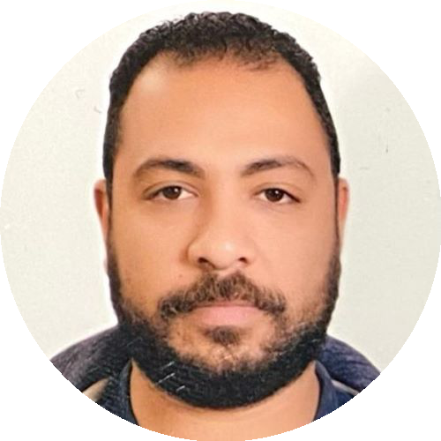
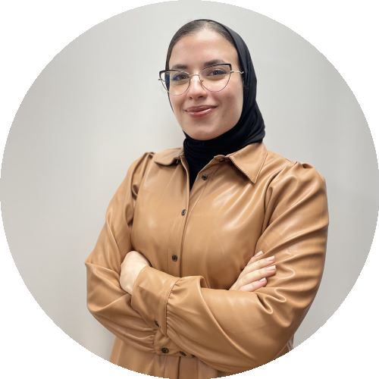
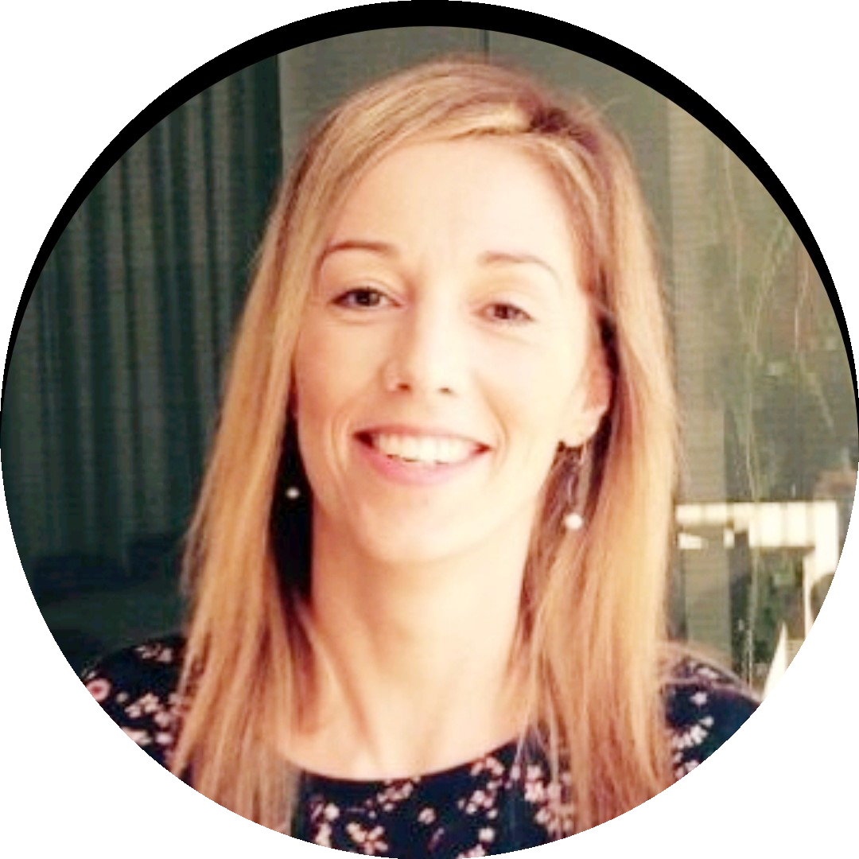
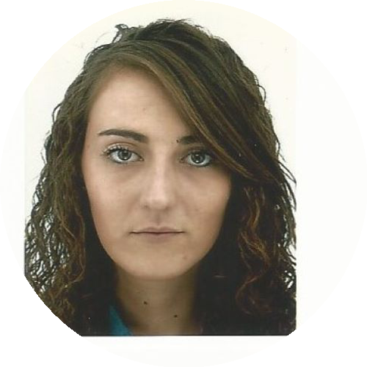
Finance Team
Finance Strategic Topics
Country Finance Topics
Managing the company’s finances
Provide strategic recommendations
Forecast, Budget and other reports
Transfer Pricing
Review vendor’s contracts
Define travel expenses and PO policy
Calculate and process pay slips
Process all payments
Invoice the customers
Check due diligence for suppliers
Process and check bills
Legal and tax compliance
Financial statements
Budget controlling
Ensure travel expenses and PO policy
Ahmed Abdallah Finance Lead
Mohamed Walid Finance Coordinator
Laura Ruz Lizarraga Finance Coordinator
Romain Benjamin Murigneux Finance Director
Business Controller Topics, supporting BD team
Saad Tariq Finance Representative
Lazzat Zhunisbek Finance Representative
Customer contracting processes (incl. due diligence)
Cleaning & controlling of BD CRM
Collections, accounts receivables
Provide reports and dashboards for BD team
Calculate VP commissions
Support the local admin tasks for the Dubai company (e.g. Health insurance)
Abdullah Hassanin Finance Senior Coordinator
Hajar Jaafar Finance Senior Coordinator
Filipa Menezes Finance Senior Coordinator
Juliette Roussel Finance Senior Coordinator

Slide 6
Human Capital
Human Capital Strategy
Professional Development
Overall steering of the Human Capital Function
Defining and implementing Infomineo HR policies across the offices
Overseeing Professional Development Initiatives
Overseeing Talent Recruitment and Retention strategies
Contributing to the overall company strategy
Staffing Committee
Training & E- Learning (Onboarding and Ongoing)
Performance Evaluation & Career Development
Consultancy and coaching for managers and their teams
Mobility programs
Recruitment
Attracting new talents
Application processes and interviews management
Recruitment event planning
Talent pool cultivation
Candidates Referrals
Attrition analysis
HR Administration & Compensation & Benefits
Labor law and compliance
Company policies & procedures
Payroll & Leave administration, incl. Social insurance
Compensation and benefit programs, incl. Health & life insurance
Administrative requests
Employees Issues, and complains
Onboarding/offboarding process

Slide 7
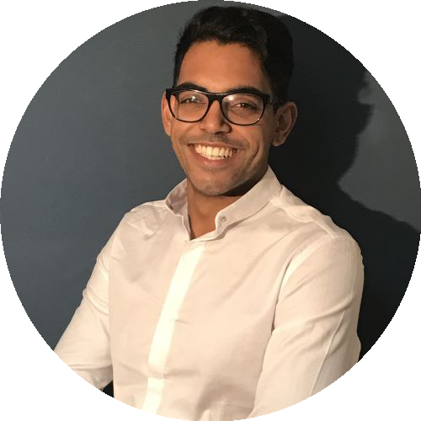
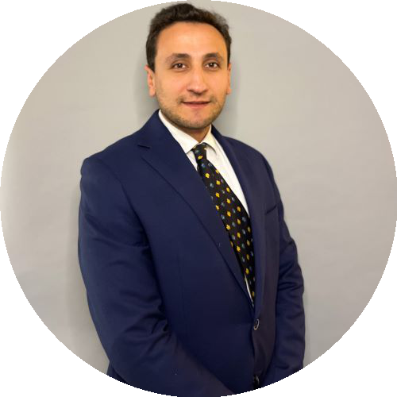
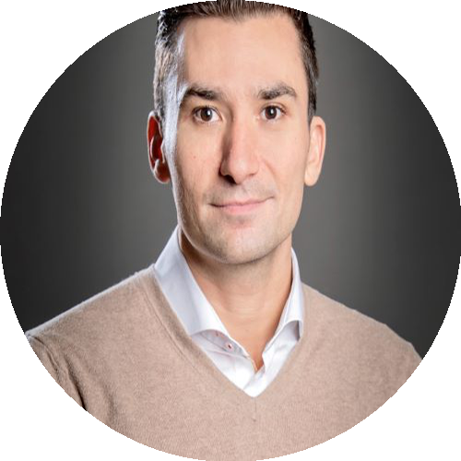
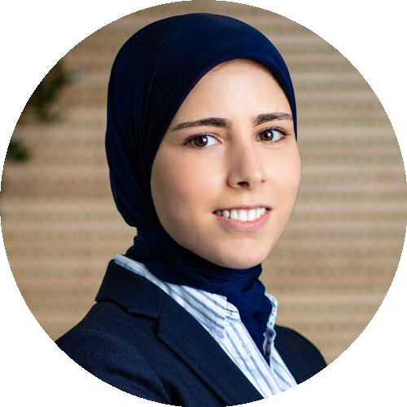
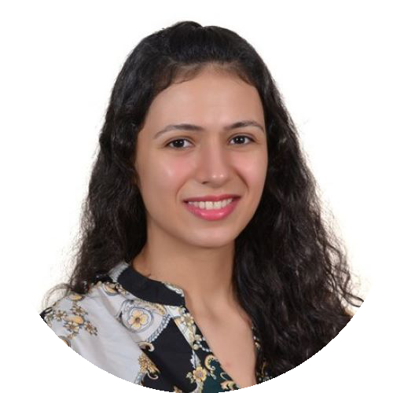
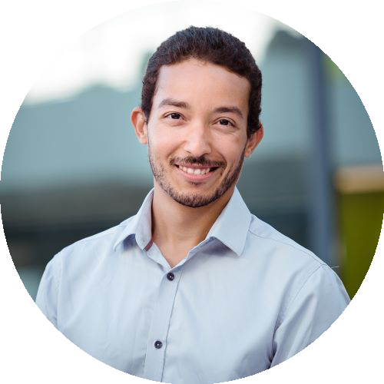
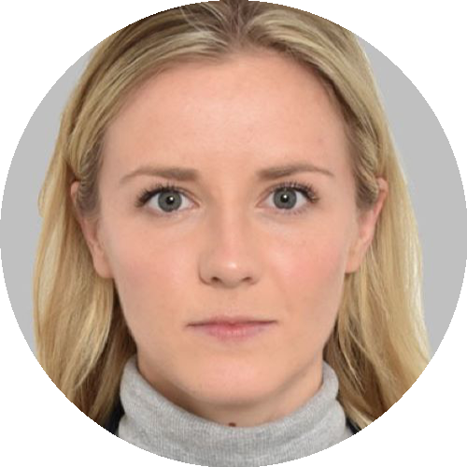
Operations Team
Who are they?
What do they do?
Chief Operating Officer
Define recruitment targets to make sure capacity meets demand
Team staffing coordination to maximize utilization levels
Define knowledge capitalization & strategies
Faizel Logday Chief Operations Officer
Country Managers
Collaborate with service teams on different matters (inl. Local administrations)
Ensure a good local value proposition to attract the best talent.
Continuous contributions to the office's profitability with Operations team
Mohamed Abdelmagid Country Manager
Luis Carlos Chapa Cardenas Country Manager
Asmaa Bennani Country Manager
Digital Transformation Manager
Lead infomineo's digital transformation projects
Focus on process improvement across departments, from support to delivery
Leverage technology to improve service quality for internal & external customers
Implement lean & continuous improvement practices
Operations’ Team Members
Data preparation for periodic reports for COO and managers
Assist the COO in setting and managing Operations metrics, goals & projects
Manage incidents related to Odoo system & Reporting
Mariam Erian Operations Senior Analyst
Amine Derj Manager of Digital Transformation
Nina Lamberts Operations Lead

Slide 8
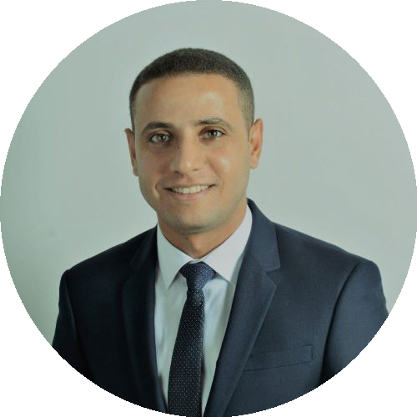
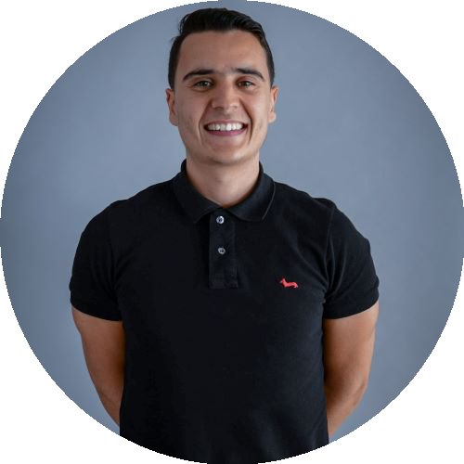
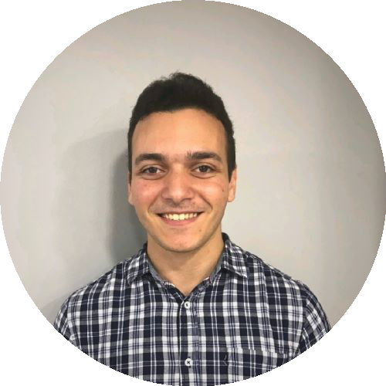
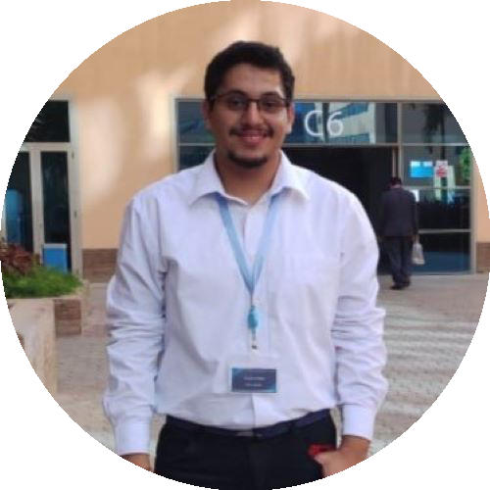
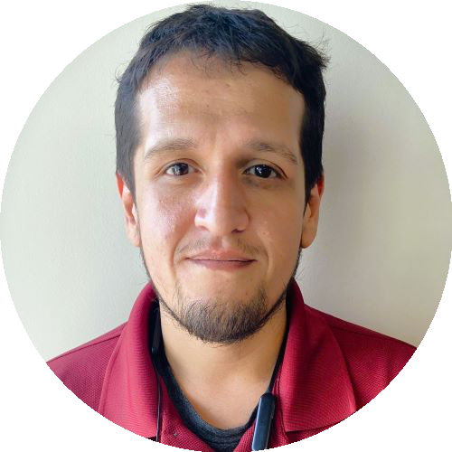
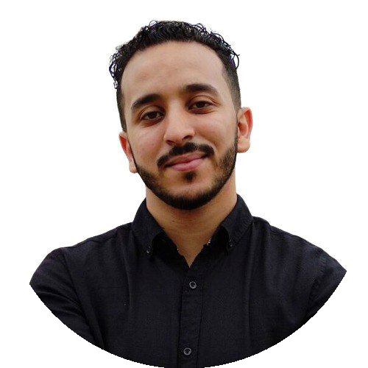

Information Technology Team
Who are they?
What do they do?
Implementing and Managing IT Systems and Networks
Providing IT Support for all business units
Mohamed Ragheb IT Manager MENA
Achraf El Allam IT Senior Manager, Europe & West Africa
System Administration and Application/Accounts Management
Ensuring IT Systems security and defining IT Policies
IT Asset Management and Purchasing
IT Onboarding/Offboarding
Kareem Ibrahem Senior IT Coordinator
Khaled Walid IT Representative
Saul Guillermo Ramiro Tovar Senior IT Representative
Aymane Jarmoune IT Representative
Douae Lahrach IT Coordinator

Slide 9
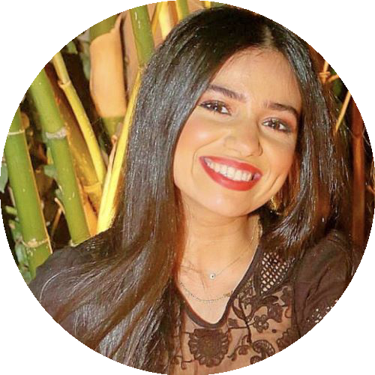
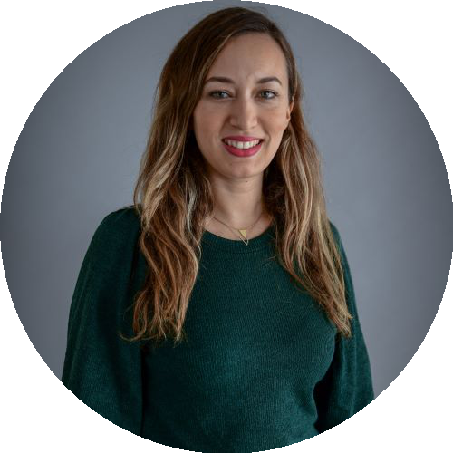
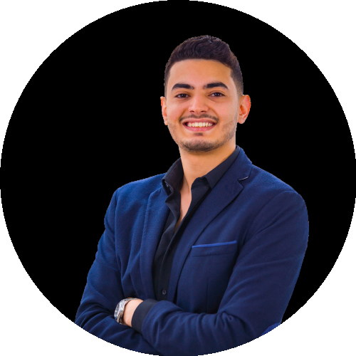
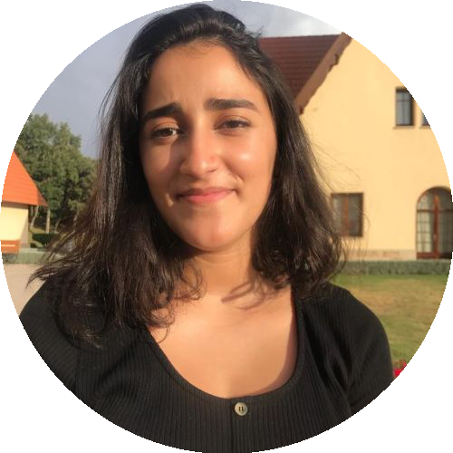
Marketing Team
Who are they?
What do they do?
Managing and improving lead generation campaigns
Kawtar El Hamdi Knowledge Management Specialist
Kenza Khaldane Marketing Senior Manager
Omar Laoudai SEO Specialist Coordinator
Zineb El Khamlichi Marketing Representative
Developing Infomineo’s Marketing Strategy
Monitoring new content.
Overseeing the development of marketing materials
Pietro Galvani Global Marketing Director
Overseeing Infomineo’s web strategy
Infomineo’s sector and region content development

Slide 10
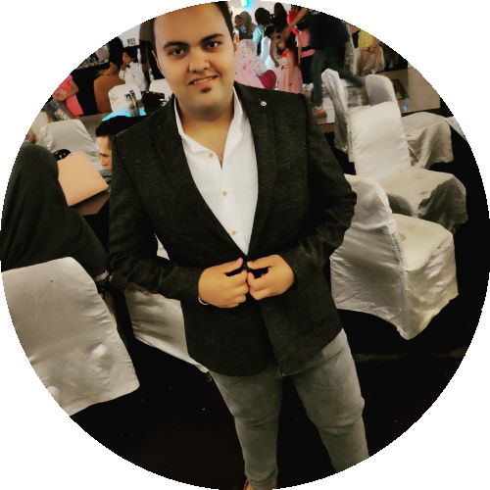
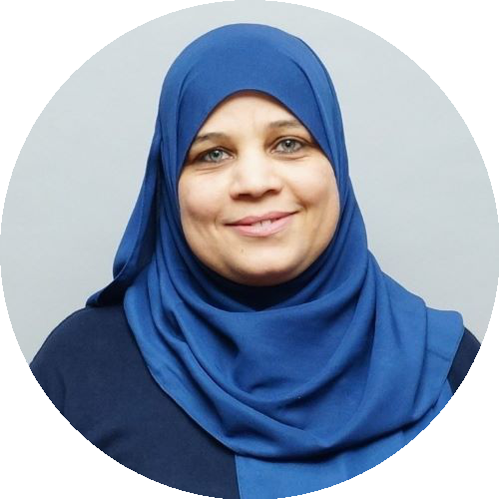
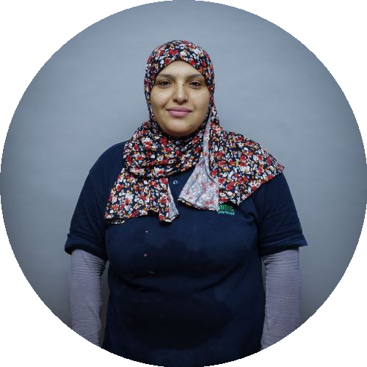






Office Admin Team
Who are they?
What do they do?
Office life events planning
General services management (e.g. clean desk, maintenance, management of cleaning force)
Security & Safety
Room & VC booking
Courier planning
Catering and every-day lunch orders
Pick-up & transfer management
Administrative procedures support (e.g. taxes, VISA, work permit, mobility program).
AXA enrollment & contribution retrieval (Casa)
Travel perk booking
Gifts purchases (work anniversaries and events etc)
Abdelrahman Shehata Office Assistant
Afaf Ibrahim Cleaning lady
Maha Sharaf Cleaning lady
Mohamed El Nokrashy Office Senior Manager
Aicha Elhor Cleaning lady
Fatema Atoufi Cleaning lady
Hassan Fajouni Office Assistant
Kawtar Ait El Berrah Office Management Representative
Nawal Hajjaj Cleaning lady
Youssef Essalhi polyvalent agent
Zineb Douah Office Lead
Jonalyn Taparan Office Assistant

Slide 11
Composed of generalists' profiles working with the different MCK offices all around the world
Align the staffing based on the sectors covered (Finance, Public sector, Energy, etc. )
Support the client both on short and long requests
Main clients / users are from:
- The Middle East (UAE, KSA, and Egypt),
-Europe (France, Iberia, Benelux, UK, Poland, etc.),
-Africa (Morocco, South Africa, Kenya, Nigeria, Angola, ..)
-ROW (USA, Canada, India, Pakistan)
Comprised of 3 different sub-teams focusing on different geographies (Europe & Africa, Middle East, and KT Global)
Each Team member having 30+ databases at their disposal incl. big names such as Euromonitor, Oxford Economics, BMI, Global Data, etc.
Working as a full off-site extension of the client research team capabilities with access to a big portion of BCG tools incl. email addresses & slack communication
Researchers work directly with the case teams with no intermediaries, mainly on short engagements (4-8 hours) although long engagements lasting weeks are becoming more regular
Offers sectorial specialization in different topics incl. (Industrial goods, Technology, Public Sector, Healthcare, Consumer products, etc.)
MCK Team
BCG
Team
Infomineo Research Teams
IKT (Insight & Knowledge) Team
Serves all of Infomineo’s clients that are not engaged in a big retainer
Execute complex projects that require strong analytical skills and creativity
Deliver high value-added insights
Build diversified expertise to support a large number of clients with different needs

Slide 12







































Business Research Leaders
Abdelrahman Soliman Team Lead
Ahmed Dessouki Team Lead
Ahmed El Deeb Manager
Ahmed El Guindy Manager
Antonio Pilogallo Senior Manager
Fadila Noureldin Manager
Farah Harb Team Lead
Federica Ibrahim Manager
Hadil Naguib Manager
Hazem Omari Team Lead
Kholoud Azzazy Manager
Loay Sherine Team Lead
Maha Salem Manager
Perihan Alhusseini Senior Manager
Sofia Aziz Team Lead
Yahia El Ghandour Manager
Cesar Armando Espinosa Resendiz Manager
Ilai Fleitman Soffer Team Lead
Jesus Rene Cazares Juarez Manager
Maria Jose Toledo Diaz Team Lead
Sophia von Oppersdorff Manager
Ahmed Salah Eddine Rkhioui Team Lead
Fadoua Nassi Senior Manager
Fadwa El Khalil Manager
Fatou Ndiaye Senior Manager
Hamza Boudallaa Team Lead
Hinde Adjar Team Lead
Houssam Ayaou Team Lead
Ibrahim Zaaimi Senior Manager
Intissar Mounaji Team Lead
Meryem Khaled Team Lead
Mohamed Taha Akhanchouf Manager
Mouad Taoufiq Team Lead
Nouha Abardazzou Team Lead
Sami El Ansari Team Lead
Zakaria Hmaiti Manager
Remote
Remote
Remote
Erickson Oduya Team Lead
Lorenzo Bruscagli Team Lead
Maria de Fatima Hidalgo Ramirez Team Lead
Konrad Kalies Head of Business Research

Slide 13















































IKT Team Members
Egypt
Abdelrahman Mamdouh Senior Analyst
Abdullah Salem Associate
Adham Soliman Senior Analyst
Ali Nafie Analyst
Amr Aref Analyst
Antoine Philip Senior Analyst
Eman Abdelmohsen Associate
Engy Ellaithy Senior Analyst
Ghada Selim Senior Associate
Hadir Ali Associate
Hussein Gouda Analyst
Malak ElKafrawy Analyst
Malak Hany Senior Analyst
Mane Djizmedjian Associate
Mariam Shabana Senior Analyst
Marwan Elseidy Senior Analyst
Mina Ibrahim Senior Analyst
Mira Rofail Associate
Mohamed Mahrous Senior Associate
Moheb Iskandar Senior Analyst
Nadine Haitham Analyst
Noor Abdelgawad Analyst
Omar Abou El Gheit Senior Associate
Omar El Kayal Senior Analyst
Omar Wahban Senior Analyst
Rawan Youssry Analyst
Reem El Maghraby Senior Analyst
Sahar Badr Analyst
Salma Ali Analyst
Salma Hesham Senior Associate
Shahd Ezzat Senior Associate
Shehab Kamal Senior Analyst
Youssef Badreddine Analyst
Mexico
Alejandro Nava Chan Senior Analyst
Ana Sofia Macias Amador Analyst
Angel Alexis Flores Portillo Senior Analyst
Cesar Tinoco Avila Senior Analyst
Fabiola Montano Hernández Analyst
Javier Alexis Aranda Salceda Senior Analyst
Jorge Sierra Villarroel Senior Analyst
Leonardo Santos Senior Analyst
María Antonieta Yarrington Morales Senior Analyst
Olga Dolores Mata Mendieta Analyst
Roger Padierna Sansores Senior Analyst
Victor Nahum Antonio Analyst

Slide 14




















IKT Team Members
Morocco
Achraf Saktiwy Senior Analyst
Amine BENMOUSSA Senior Analyst
Anas Ghoulam Associate
Chaimaa Bencheikh Associate
Chouaib Hidara Senior Analyst
Mahmoud Benchicou Analyst
Meryem Moutmir Senior Analyst
Mohamed Ali Al Kharassani Analyst
Mohamed Kamal Zaraba Senior Analyst
Mohamed Saidi Associate
Mohammed Berrada Senior Analyst
Nada Faris Analyst
Ossama Labiad Senior Analyst
Wiame Anaya Analyst
Yasmine Aazim Analyst
Yassin El Hardouz Analyst
Yassine Falk Senior Analyst
Younes Kabbaj Senior Associate
Youssef Abdelmoutalib Analyst
Zineb Benmhalla Analyst
Zyad Channoufi Senior Analyst
Remote

Slide 15






























MCK Team Members
Egypt
Abdulrhman Salah Senior Analyst
Ahmed Atef Associate
Ahmed Ayad Analyst
Hazem El Okda Senior Analyst
Hussien Elzayady Analyst
Lobna Selim Senior Analyst
Makary Philemon Analyst
Mariam Abd El-Aziz Associate
Mariam Khalil Analyst
Mayar Gaber Analyst
Mazen Abdelaal Analyst
Mohamed Mohsen Analyst
Nadine Khalifa Senior Analyst
Nour Samy Analyst
Rana Abo El Abbas Senior Analyst
Randa Elokdah Associate
Salma Ghanem Analyst
Mexico
Alina Castillo Espinoza Analyst
Bernardo Casas Nader Analyst
Carlos Camp Talavera Senior Analyst
Carlos Eugenio Trevino Guerr Analyst
Daniel Ramos Loera Associate
Derek David Vallejo Arroyo Senior Analyst
Fernanda Rios Herrera Analyst
Hector Antonio Ruiz Guevara Senior Associate
Hector Gonzalez Magaña Analyst
Marie Genia Mallmann Analyst
Mauricio Lankenau Vela Analyst
Meliza Rivas Contreras Senior Analyst
Omar Alfredo Gasca Basilio Senior Analyst

Slide 16





















MCK Team Members
Morocco
Abdelkabyr Lachhab Associate
Abdessalam Falsy Senior Analyst
Achraf Salmane Analyst
Aida Mekouar Analyst
Boutaina Benaboud Associate
Camilla Lupiani Analyst
Fadoua Akhoullou Analyst
Fatimazohra Aboulfoujja Analyst
Ilyas Lahouioui Senior Analyst
Kenza Abadi Associate
Khadija Boucht Associate
Khawla Khrifi Senior Analyst
Mariyam Tahri Senior Analyst
Maroua Benjillali Associate
Nada Krat Analyst
Omar Rguibi Associate
Rachid Lafnich Senior Analyst
Wail Sallaq Analyst
Yasmina Iben Brahim Associate
Zakia Azzedin Analyst
Remote
Jonathan Sumbobo Associate

Slide 17




















BCG Team Members
Egypt
Ali Kabil Senior Analyst
Amina Helmy Analyst
Ayten Ismail Associate
Dina Amer Associate
Hebatallah Mohamed Senior Analyst
Ignacio Jimenez Associate
Islam Essa Associate
Khaled Zahran Analyst
Laila Karam Senior Analyst
Marie Jose Tarazi Senior Analyst
Mohamed Diaa Analyst
Mohamed Ghareeb Senior Analyst
Mohamed Tawakkol Analyst
Mohammad Sayed Senior Associate
Nada Shabaka Analyst
Nadine Hashad Senior Associate
Rola Hesham Associate
Sarah Dawerkly Senior Analyst
Seif Ghanem Analyst
Shaimaa Radi Senior Associate
Mexico

Slide 18






















BCG Team Members
Morocco
Aawatif Mounkid Analyst
Abderrahmane Bahmida Senior Analyst
Amina Bahlaouane Senior Analyst
Amine Fellahi Analyst
Assia Sabir Analyst
Ayda Benjelloun Analyst
Badr El Kamli Senior Analyst
Hiba El Harrak Senior Analyst
Ismail El Bouni Senior Analyst
Ismaïl El Mansouri Analyst
Iuliia Ivanova Associate
Jihane Benazzouz Associate
Khawla Jaidi Associate
Othmane Jabal Analyst
Othmane Moustahsine Associate
Oussama Stouky Associate
Sara Adnaoui Associate
Soulaymane Ezzoubdaoui Analyst
Wafaa Benlahbib Senior Analyst
Youssef Mimil Analyst
Zouhour Jomaa Associate
Remote
Pietro Morabito Senior Associate

Slide 19




























Business Translation Team
Ahmed Elsayed Team Manager
Hazem Adel Business Line Manager
Mohamed Shokhba Team Lead
Ahmed Laheeb Senior Associate
Ahmed Saied Business Translator
Asmaa Hafez Associate
Hagar Elmougy Associate
Hager Farouk Business Translator - Senior
Hana Nasser Business Translator - Senior
Hend Alaaeldin Business Translator - Senior
Islam Fadel Associate
Lara Lotfy Business Translator
Mariam Gharieb Senior Associate
Mariam Hassan Associate
Mariam Morsy Business Translator
Marina Eskander Business Translator - Senior
Maryam Magdy Business Translator
Menna-Tuallah Moustapha Associate
Omnia Yousef Business Translator
Raghda Marzouk Business Translator - Senior
Rana Omar Business Translator
Sally Khaled Senior Associate
Samar Saad Associate
Sara Cherif Business Translator
Sherry Magdy Business Translator
Yara Hassan Senior Associate
Yomna Hassan Business Translator - Senior
Zeina Abdelazim Business Translator

Slide 20
























Graphic Design Team
Mohamed Osman Graphic Design Senior Manager
Noha Nagib Graphic Design Creative Lead
Victor Miguel Sanchez Solano Manager
Hamza Lahlou GD Business line Manager
Siham Zaim Idrissi Manager
Ahmed Hesham Graphic Designer Senior
Aya Abdallah Graphic Designer Senior
Bassant Khaled Graphic Designer - Junior
Mariam Ramzy Graphic Designer - Junior
Radwa Najjar Graphic Design Project Coordinator
Samia Elkhodary Graphic Designer Senior
Diana Laura Cisneros Graphic Designer
Joaquin Castro Caceres Graphic Designer Senior
Karla Jamileth Martínez Cancino Graphic Designer
Shania Karen Ruiz Gómez Graphic Designer
Abdellah Badis Graphic Designer - Junior
Amine Hijaoui Graphic Designer
Sophia Nasrallah Graphic Design Creative Lead
Fatima Zahra Moussali Graphic Designer
Ikram IMAKBOUBEN Graphic Designer
Imane Zouba Graphic Designer
Mohamed Yassine Graphic Designer - Junior
Othmane Senhadji Graphic Design Specialist
Youssef Boudaka Graphic Designer Senior

Slide 21







Data Analytics Team
Ahmed Singer Data Science Manager
Hadia Ibnabdeljalil Head of Data Analytics Services
Remote
Brahim Alami Hassani Data Scientist - Senior 1
Khaoula Qassibi Data Analyst 1
Mohamed Amine Lahouani Data Scientist - Senior 2
Youssef Moutaouakkil Data Scientist 1
Oludayo Oluwaseun Abass Data Scientist - Senior 1

